Slide 1
Starter: Remind yourself of the poem and your notes for Exposure
Our brains ache, in the merciless iced east winds that knive us . . .
Wearied we keep awake because the night is silent . . .
Low drooping flares confuse our memory of the salient . . .
Worried by silence, sentries whisper, curious, nervous,
But nothing happens.
Watching, we hear the mad gusts tugging on the wire,
Like twitching agonies of men among its brambles.
Northward, incessantly, the flickering gunnery rumbles,
Far off, like a dull rumour of some other war.
What are we doing here?

Slide 2

Assessment Objectives
AO1: Read, understand and respond to texts. Students should be able to: maintain a critical style and develop an informed person response; use textual references, including quotations, to support and illustrate interpretations.
AO2: Analyse the language, form and structure used by a writer to create meanings and effects, using relevant subject terminology where appropriate.
AO3: Show understanding of the relationships between texts and the contexts in which they were written.
AO4: Use a range of vocabulary and sentence structures for clarity, purpose and effect, with accurate spelling and punctuation.
Notes:
Resource 1. Additional help for this task can be found on p. 6 & 7 in the poetry student book.

Slide 3
Date:
Power or conflict?
Title:
Poet:
Main Idea/ Theme:
Language:
Imagery:
Context:
Tone:
Rhythm/ Rhyme:

Slide 4
Date:1917/18
Power & conflict
Title: Exposure
Poet: Wilfred Owen
Main Idea/ Theme:
Even in the midst of war, nature kills more men than warfare.
Language:
Assonance
Sibilance
Alliteration
Semantic fields of war and weather
Imagery:
Personification
Contrasts
Context:
Written about men stationed on the Ypres Salient during WWI and written whilst Owen was hospitalised in 1917.
Tone:
Reflective but bleak, melancholy
Rhythm/ Rhyme:
Pararhyme (half rhyme) loosely using ABBA

Slide 5
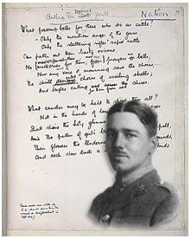
Wilfred Owen (1893-1918)
Copy down into your notes
Owen was teaching in France when WW1 broke out. He enlisted and was sent to the front in 1916.
He met fellow poet Siegfried Sassoon in hospital and he became a major influence on Owen. He is also the one who had Owen’s poems collected, edited and published after Owen died in combat in November 1918.
Owen’s mix of realism and the ideas he had gained from his study of the romantic poets (particularly Keats and Shelley) created a unique poetic voice which is seen as perfectly fitting the heroism and tragedy of WWI.

Slide 6
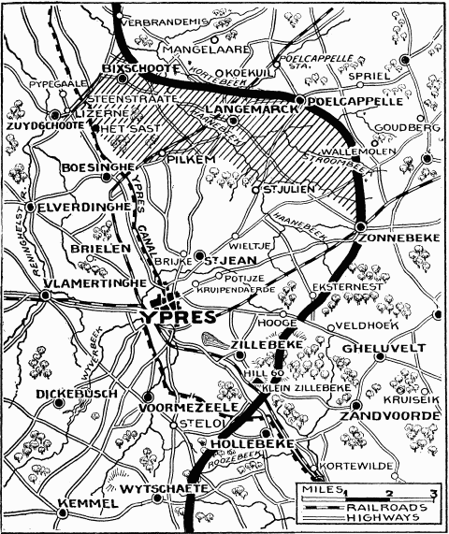
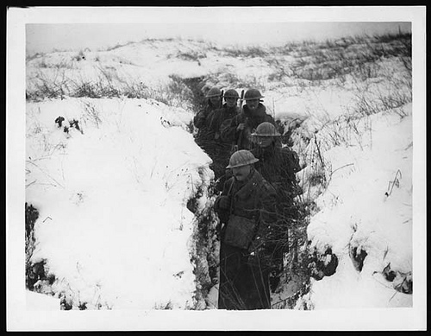
Context and glossary
YPRES SALIENT

Slide 7
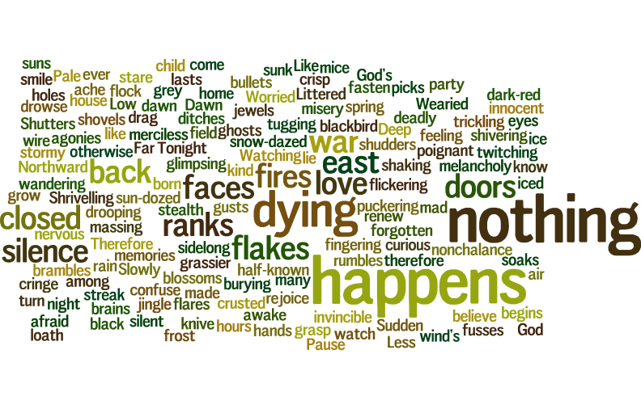
Repeated words and ideas

Slide 8
The focus at the end of each stanza:
Each stanza ends in a short line which builds on the previous stanza
Stanza 1: ‘But nothing happens’
Stanza 2: ‘What are we doing here?’
Stanza 3: ‘But nothing happens’
Stanza 4: ‘But nothing happens’
Stanza 5: ‘Is it that we are dying?’
Stanza 6: ‘We turn back to our dying’
Stanza 7: ‘ For love of God seems dying’
Stanza 8: ‘But nothing happens’
What is the effect of the repetition?

Slide 9
